Slide 1

Custom IDA Sidharth Bansal Employee Id : 655314

Slide 2
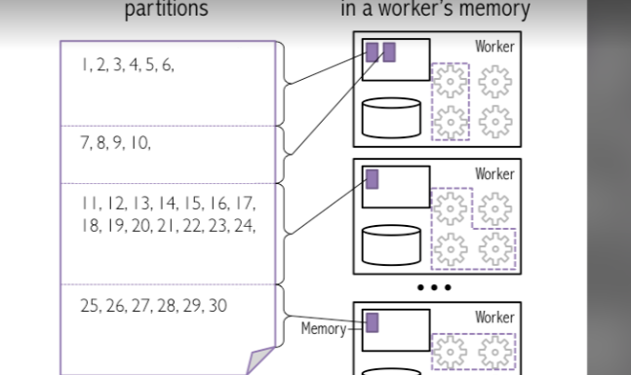
Day 1 25th September
Used withColumnRenamed() function in pyspark to rename the columns
Used partionBy() to divide and store the data based on the year
Coalesce vs Repartition
Learned how to handle null data

Slide 3
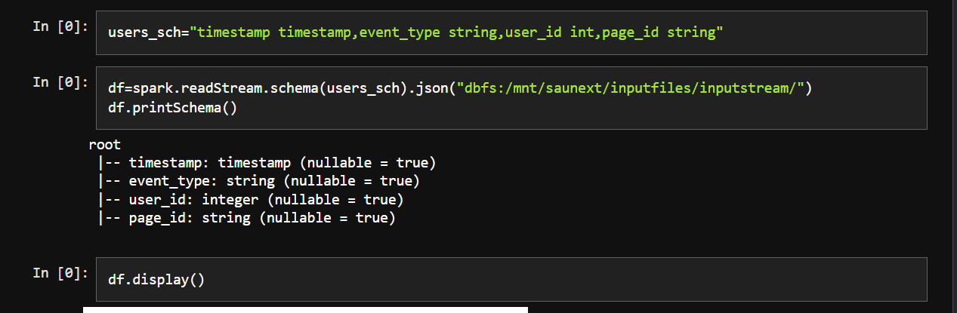
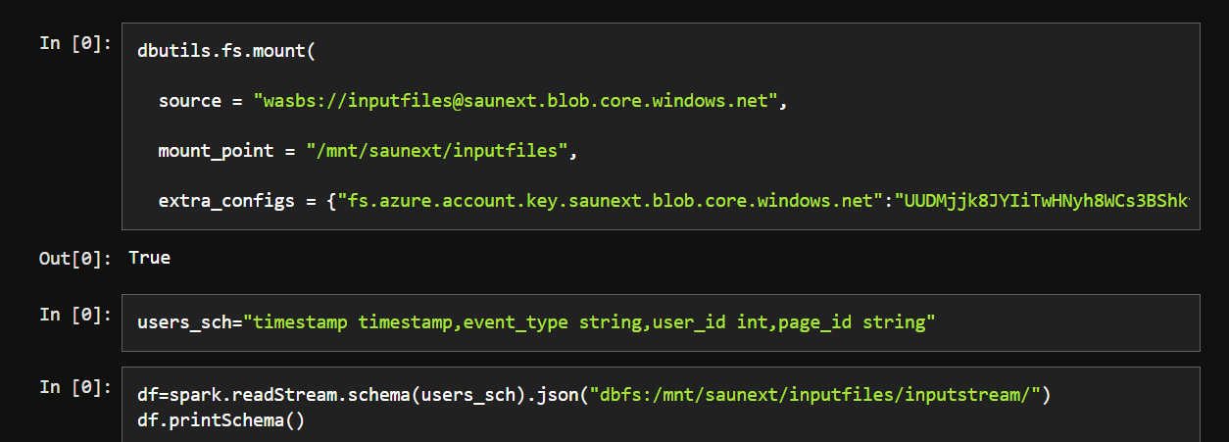
Day 2 26th September
Databricks architecture
Tried basic commands of SQL,pyspark in databricks
Created Dataframe and saved it as a table
Connected databricks to data lake and mounting using SPN, access key and SAS
Learned about streaming in pyspark

Slide 4
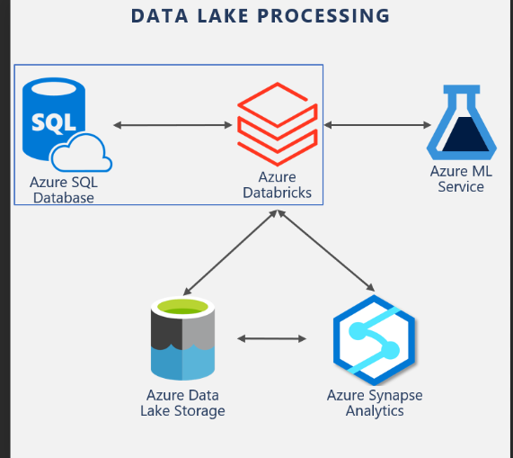
Day 3 27^{h} September
Security and Data Protection in data bricks
Hands on connection of databricks to github for pushing of code
Learned about delta lake concept and error handling
Hands on setting up azure SQL endpoint using databricks

Slide 5
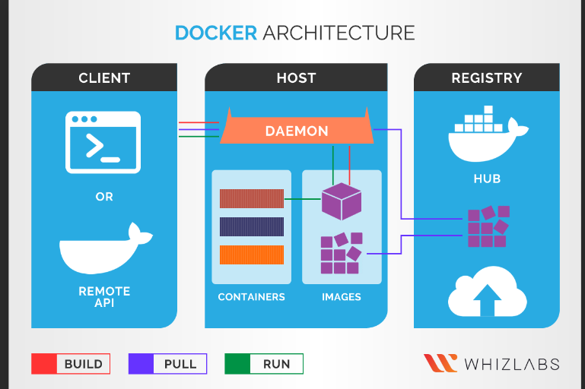
Day 4 28th September
Introduction to docker
Hands on creation of dockerfile and dockerimage
Deploying the azure container images
Introduction to Kubernetes

Slide 6
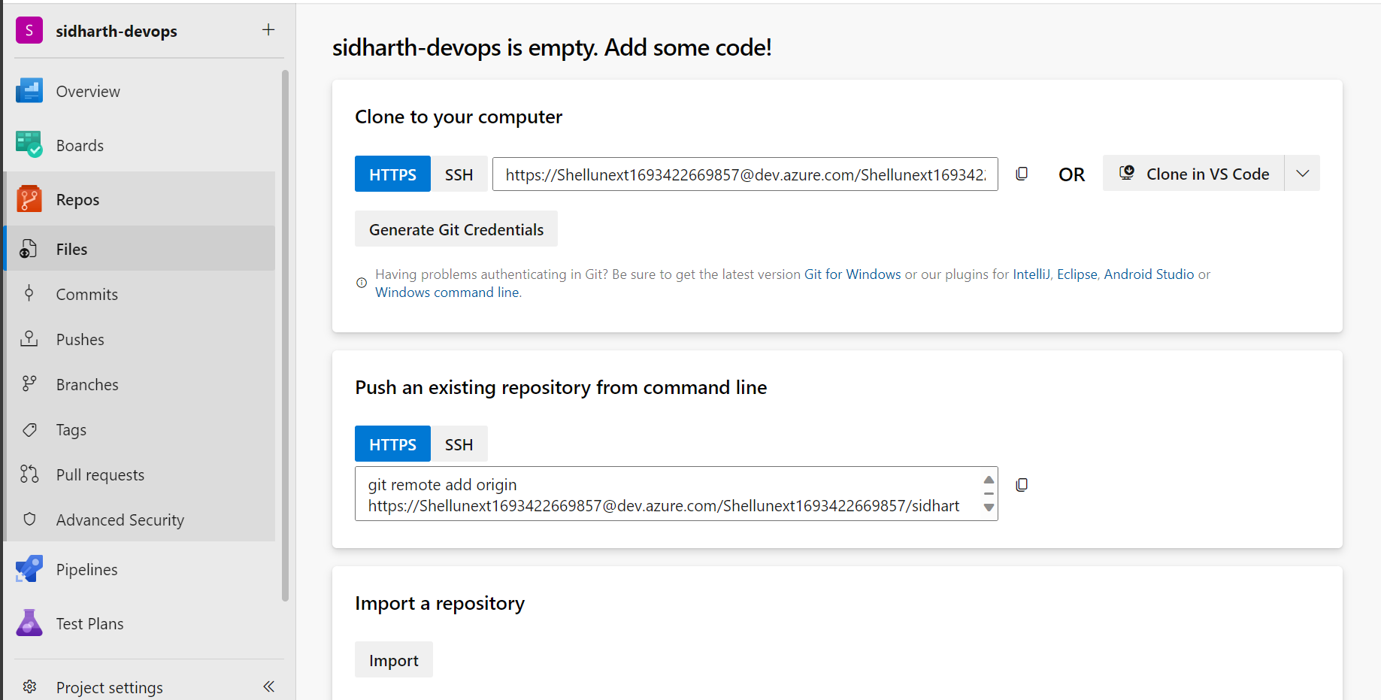
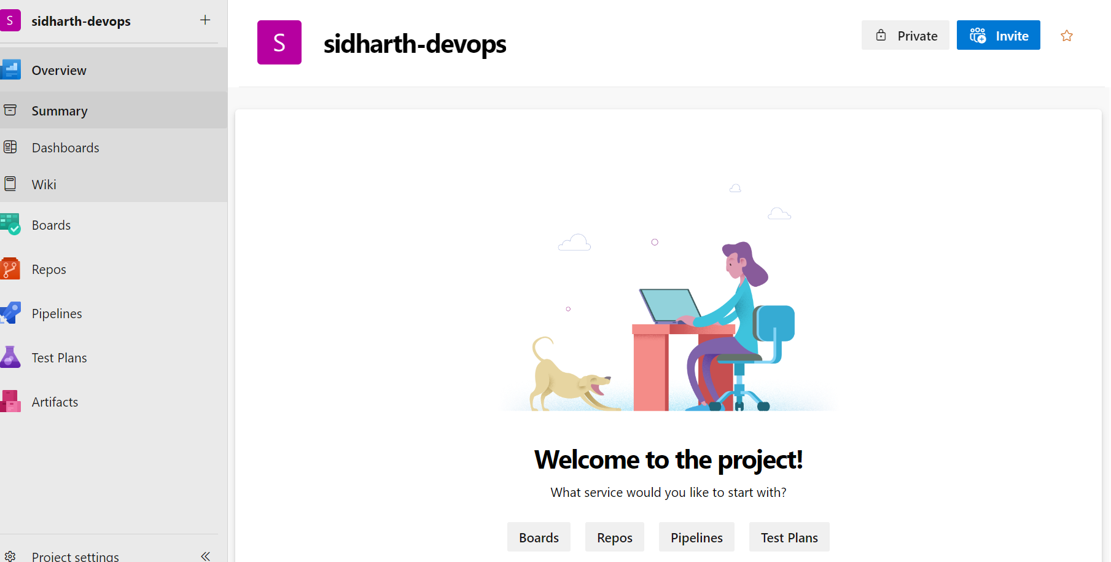
Day 5 29th September
Learned about Waterfall and Agile methodologies
Waterfall vs Agile methodologies
Overview of azure devops
Introduction of continuous integration and continuous deployment
Github repos and Github actions integeration

